Slide 1






TASK #4
PROJECT
By Tuqa Mazin
Ahmad
Adham

Slide 2
Objective
The objective of this project is to analyze factors affecting taxi fare amounts using real-world trip data.
Through exploratory data analysis (EDA), we aim to:
Identify the most influential features affecting fare
Understand how variables like distance, time, passenger count, and weather relate to pricing
Detect any data inconsistencies or outliers
Provide actionable insights for pricing models, fraud detection, and customer experience

Slide 3
DATA OVERVIEW
There are 5 rows with missing values in the following columns: bearing, distance, nyc_dist, sol_dist, lga_dist, ewr_dist, jfk_dist, dropoff_longitude, dropoff_latitude.
All of these columns are related to location and distance → so most likely 5 trips missing coordinates or distance calculations.
Number of negative values in fare_amount: 21
Number of trips with a distance of 0: 14250 Project Scope
✔️ Removing all trips with distance = 0 is a very good decision.
Why?
Price is not actually related to actual distance.
It incorrectly affects models and correlations.

Slide 4

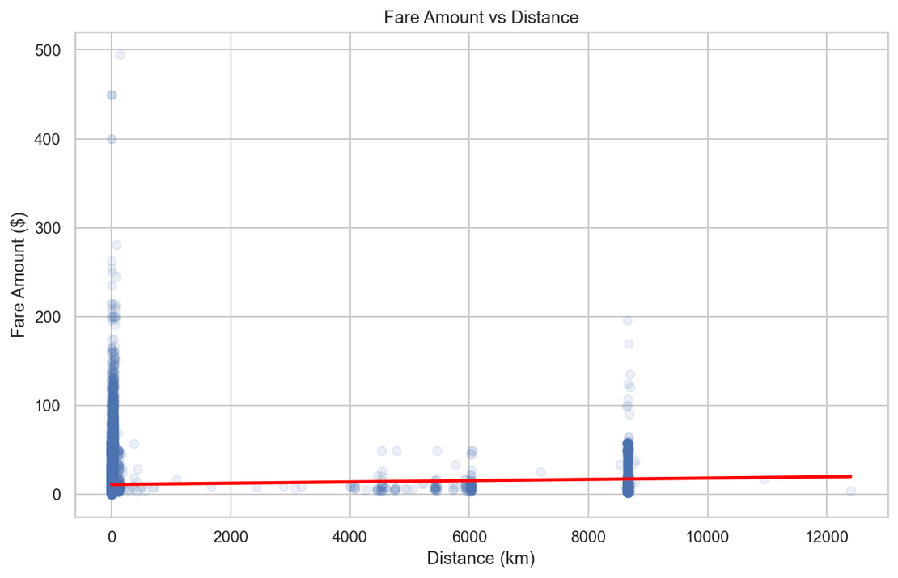
DOES THE FARE INCREASE
WITH DISTANCE?
There is a direct relationship between distance and fare, meaning the greater the distance, the greater the fare, and this is very logical.

Slide 5

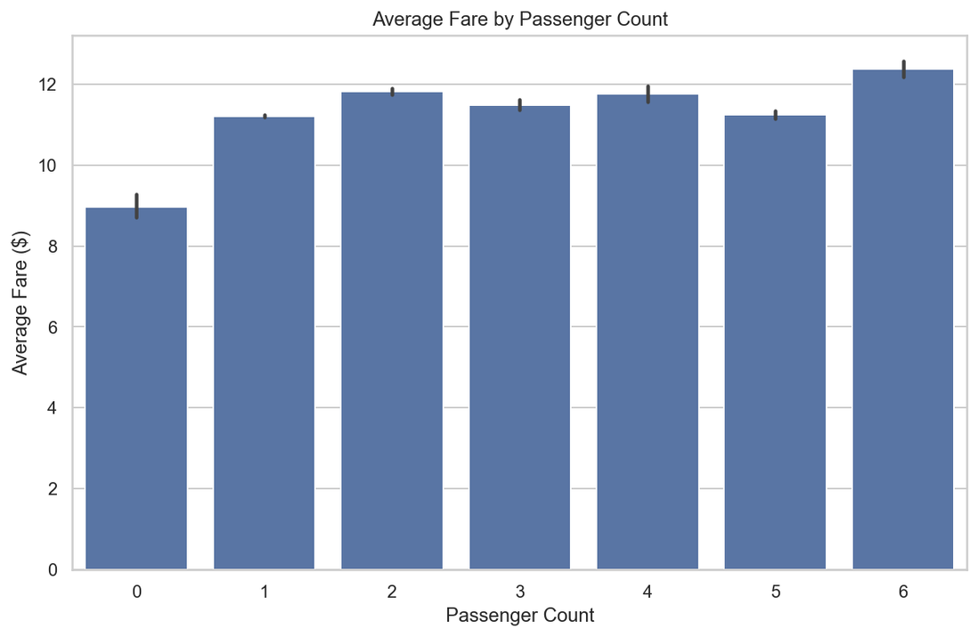

HOW DOES THE AVERAGE FARE CHANGE DEPENDING ON THE NUMBER OF PASSENGERS?
Most trips have one or two passengers, and the average fare is between $11 and $12.
Passengers with zero passengers (possibly unclear data or empty trips?) have a lower average.
There isn't much difference between the number of passengers from one to six, with slight fluctuations.

Slide 6
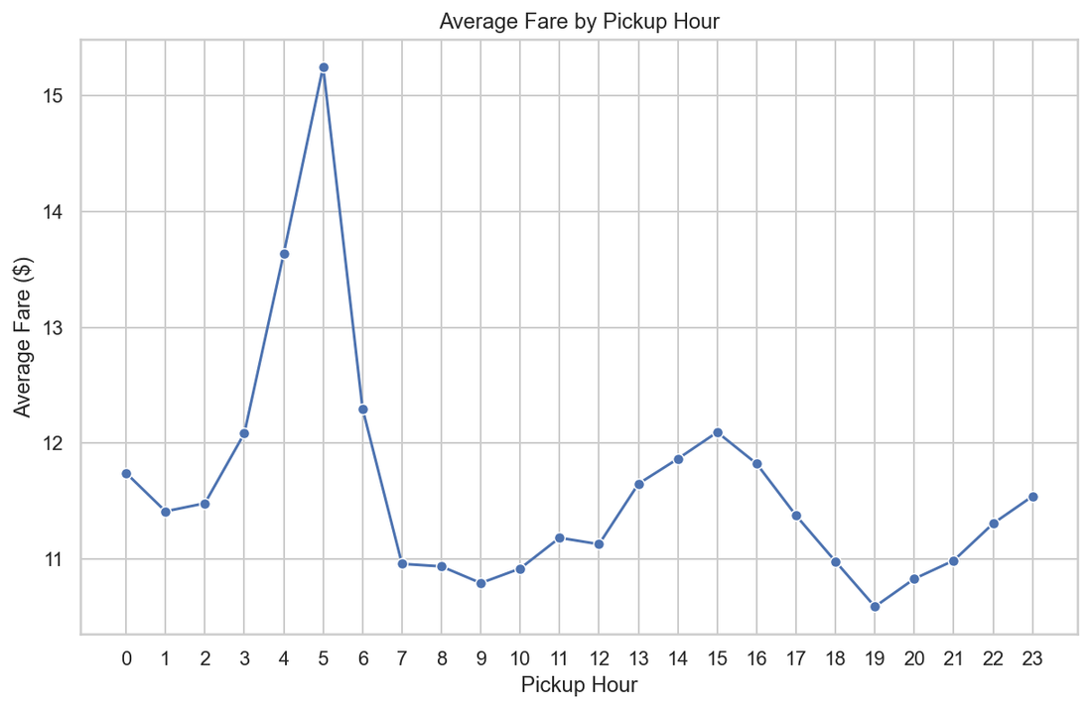
HOW DOES THE AVERAGE FARE CHANGE BY HOUR OF THE DAY?
There is a noticeable increase in the early morning (4-6 AM) and a slight increase in the afternoon (13-16 AM).
This can be attributed to increased demand or certain traffic conditions.

Slide 7


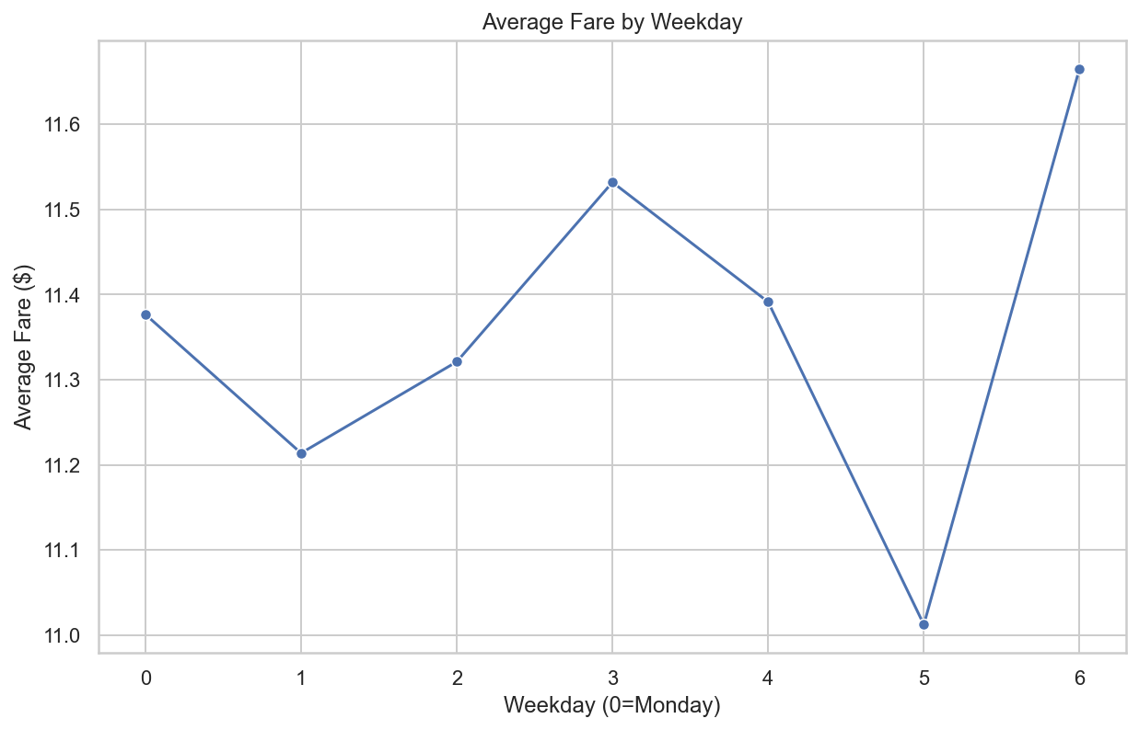



HOW DOES THE FARE VARY DEPENDING ON THE DAY OF THE WEEK?
THE FARE IS VERY SIMILAR ACROSS THE DAYS OF THE WEEK, WITH A SLIGHT DIFFERENCE FAVORING SATURDAY (6).
THE DIFFERENCE IS VERY SLIGHT, MEANING THE DAY OF THE WEEK DOESN'T SIGNIFICANTLY AFFECT THE FARE.

Slide 8


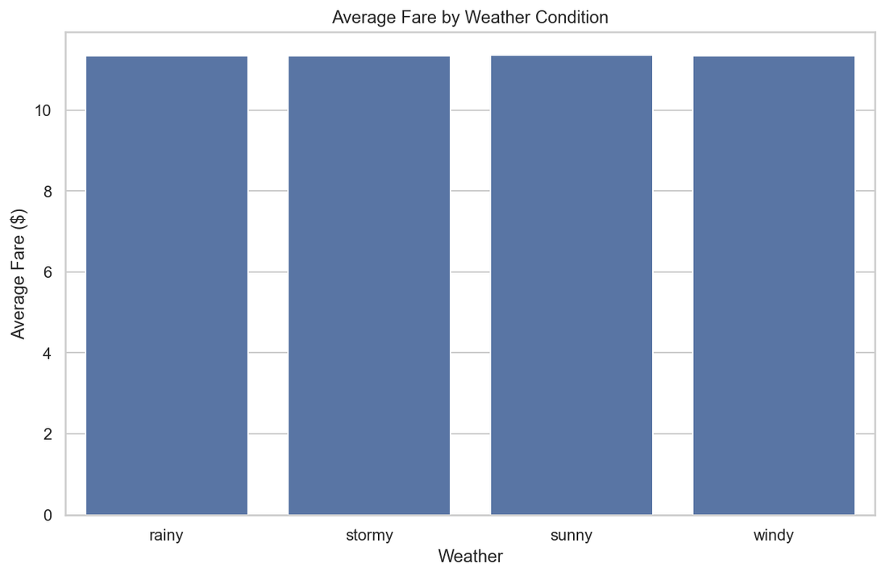

HOW DOES WEATHER AFFECT AVERAGE FARE?
The average fare is similar across "sunny," "rainy," "stormy," and "windy" weather.
There are no clear differences, which may mean that weather does not directly affect the fare.

Slide 9
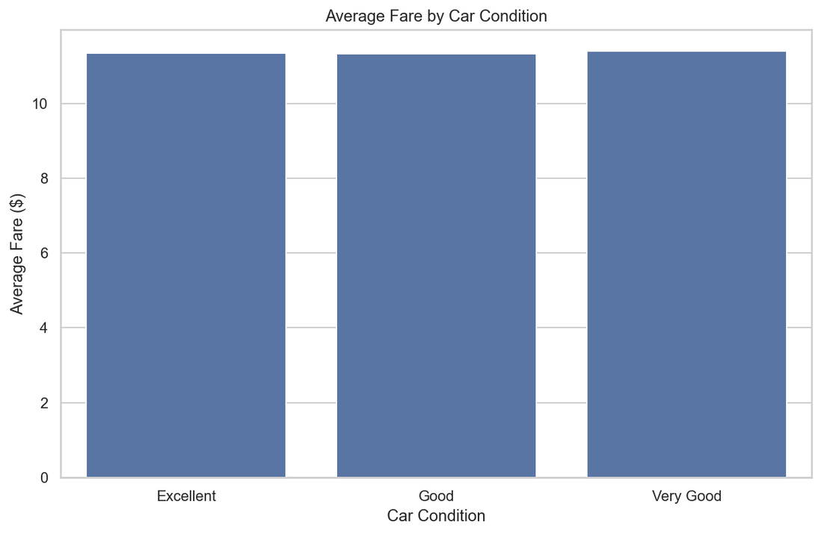
DOES THE CONDITION OF THE CAR AFFECT THE FARE?
There's no noticeable difference between "Excellent," "Good," and "Very Good" ratings.
The average fares are very similar, perhaps because fares are determined by distance and time, not by vehicle condition.

Slide 10
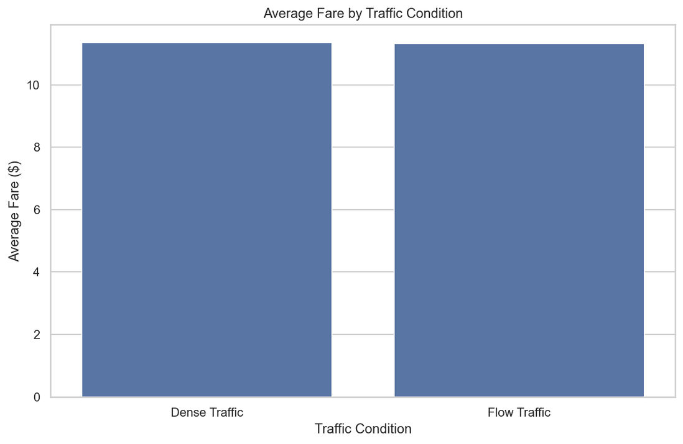
DOES TRAFFIC AFFECT THE FARE?
The differences between "traffic jams" and "smooth traffic flow" are very small.
This may indicate that the toll system does not take traffic conditions into account significantly, or that the effect is only apparent in the averages.

Slide 11


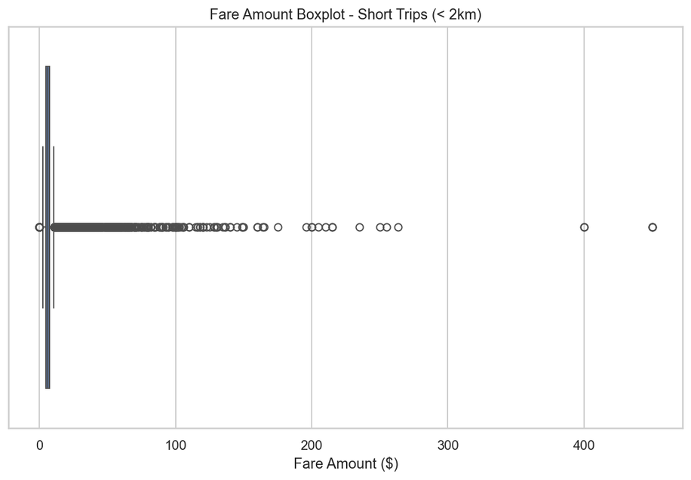

ARE THERE OUTLIERS ON SHORT TRIPS?
(E.G., DISTANCE < 2 KM AND FARE > $100)
Number of short trips with fare > $100: 56

Slide 12
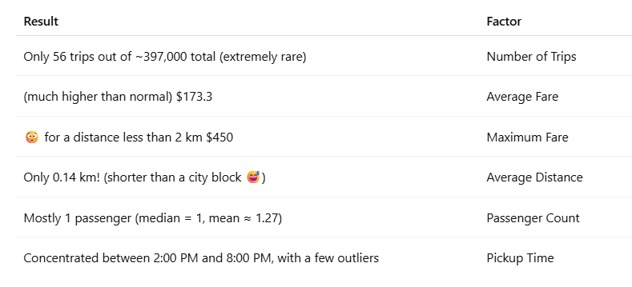
ARE THERE OUTLIERS ON SHORT TRIPS?
(E.G., DISTANCE < 2 KM AND FARE > $100)
The average fare is similar across "sunny," "rainy," "stormy," and "windy" weather.
nreasonable Pricing for Near-Zero Distances
Fares between $400–$450 for trips under 0.01 km are nearly impossible — likely due to data entry errors, fraud, or synthetic data.
🧩 2. Time Pattern?
Most of these trips occurred in the afternoon to evening period.
However, the distribution is not strong enough to conclude a consistent peak-time pattern.
🧩 3. Passenger Count
About 93% of these trips had only one passenger.
There is no logical explanation for such high fares in single-passenger short-distance rides.

Slide 13
Key Insights
✅ Distance is the most significant factor affecting fare. A clear upward trend shows that as distance increases, fare increases — this was confirmed using both feature importance and direct fare-distance visualizations.
⏰ Time of day has a minor effect on fare. Slight increases in early morning and afternoon hours, likely due to higher demand or traffic flow.
☁️ Weather, traffic, and car condition do not meaningfully impact fare. Average fares remain consistent across stormy, sunny, and windy weather, and across traffic or car quality.
👥 Number of passengers has little influence. Whether 1 or 6 passengers, fare remains fairly stable, suggesting it's not tied to group size.
🚨 Data outliers exist — especially high fares for very short distances. Trips under 2 km with fares over $100 likely indicate errors or synthetic data.

Slide 14
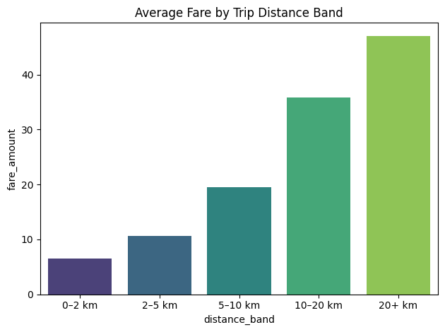
Summary
Most Affecting Feature: ➤ Distance has the clearest and most consistent positive correlation with fare.
Less Impactful or Neutral Factors: • Time of day (minor impact) • Day of week (minimal difference) • Number of passengers (slight fluctuations) • Weather, car condition, and traffic (negligible effect)

Slide 15

THANK YOU!

